Slide 1
Progress Report
Chen, Chien-Hua
陳芊樺
July 2, 2020

Slide 2
Part A. Voltage Setting of Mass Spectrometer

Slide 3
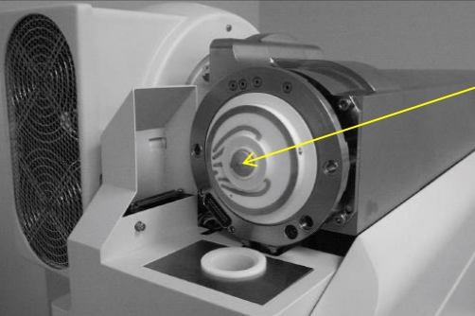
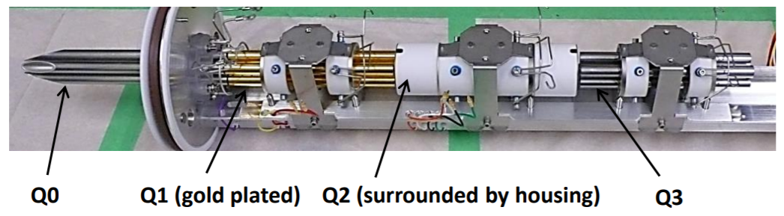
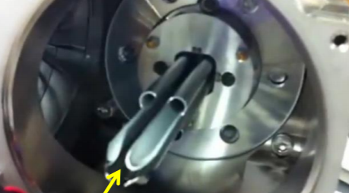
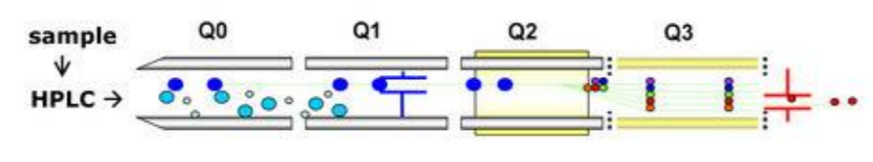
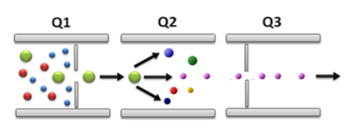
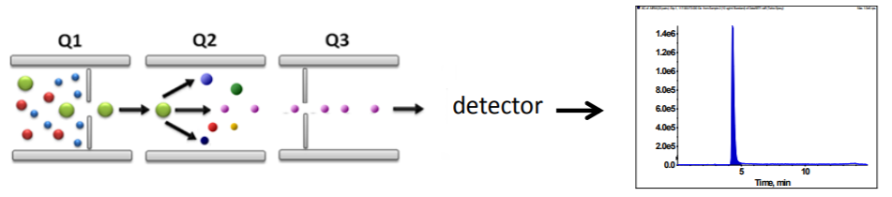
Voltage Setting - DP, EP, CE, CXP
DP: Declustering Potential (去簇電壓) prevent the ions from clustering together
EP: Entrance Potential (射入電壓) focus the ions into the mass spectrometer
CE: Collision Energy (碰撞電壓) refers to the rate of acceleration as the ions enter Q2
CXP: Collision Cell Exit Potential (撞擊室射出電壓) focuses and accelerates the ions out of Q2 and into Q3

Slide 4
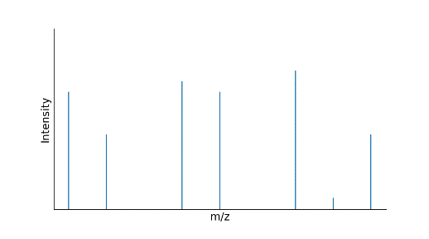
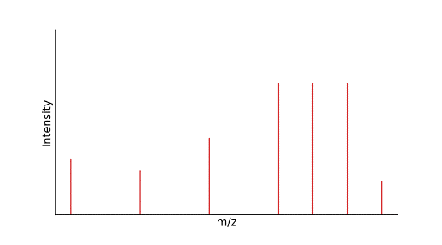
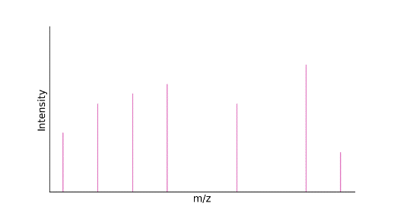
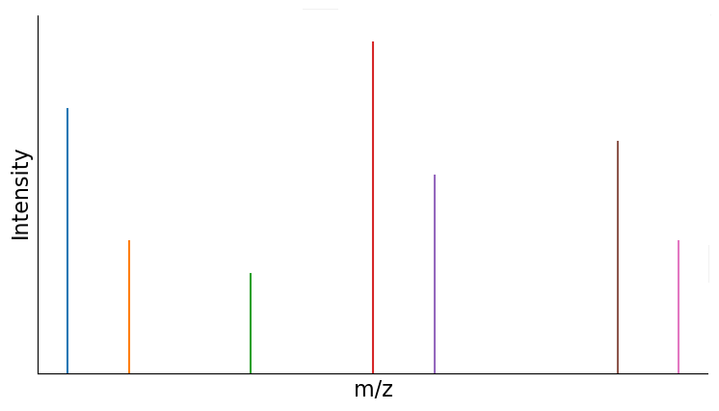
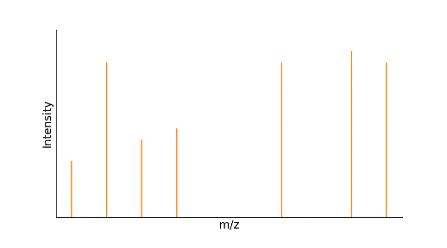
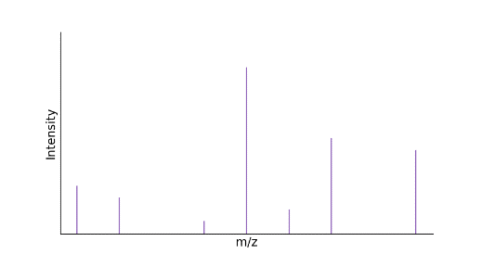
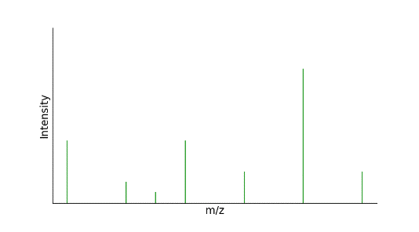
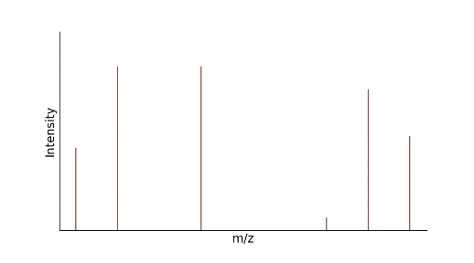
Mass Spectrometer
DP, EP
Q3
Q1
CE, CXP
(Collision)

Slide 5
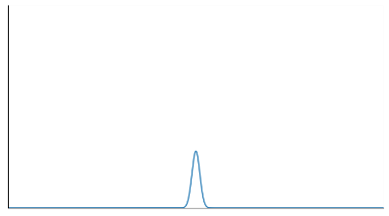
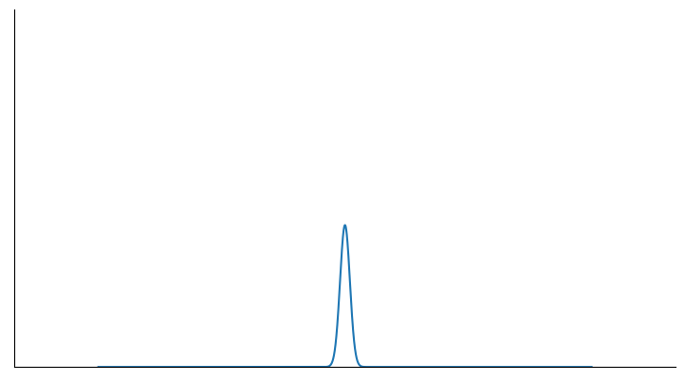
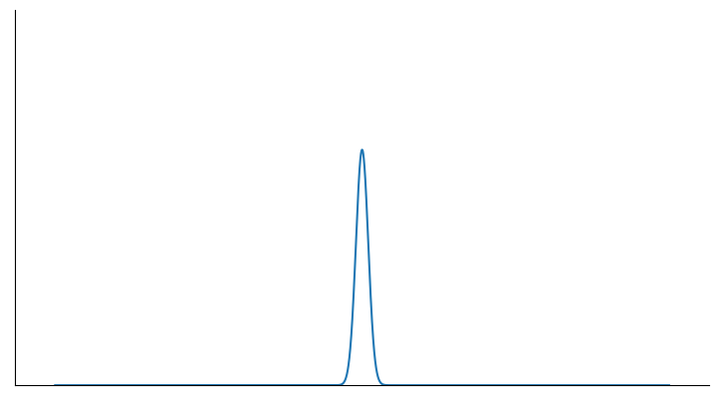
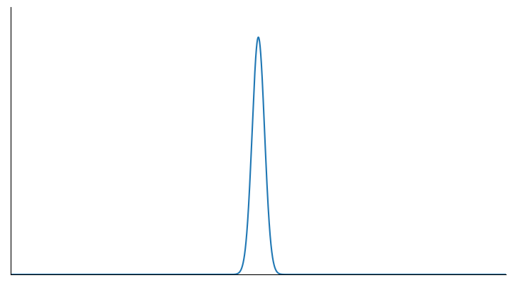
Prediction Strategy
DP, EP: Area under MS intensity peak of Q1 peptide
CE, CXP: Area under MS intensity peak of Q3 peptide
CE=5
e.g.
CE=10
Q3
CE=15
.
.
.
Repeat
in different CE voltages
CE=20
.
.
.
.
.
.

Slide 6
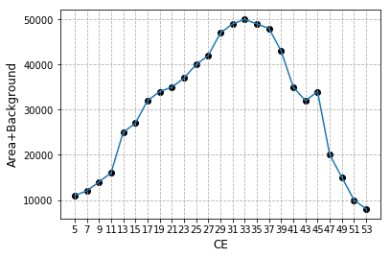
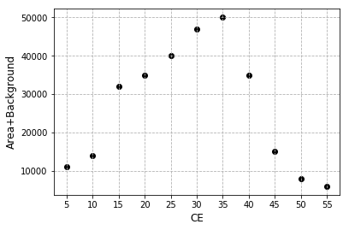
Prediction Optimal DP, CE, EP and CXP
Only 11 points!
manual
automatic
33

Slide 7
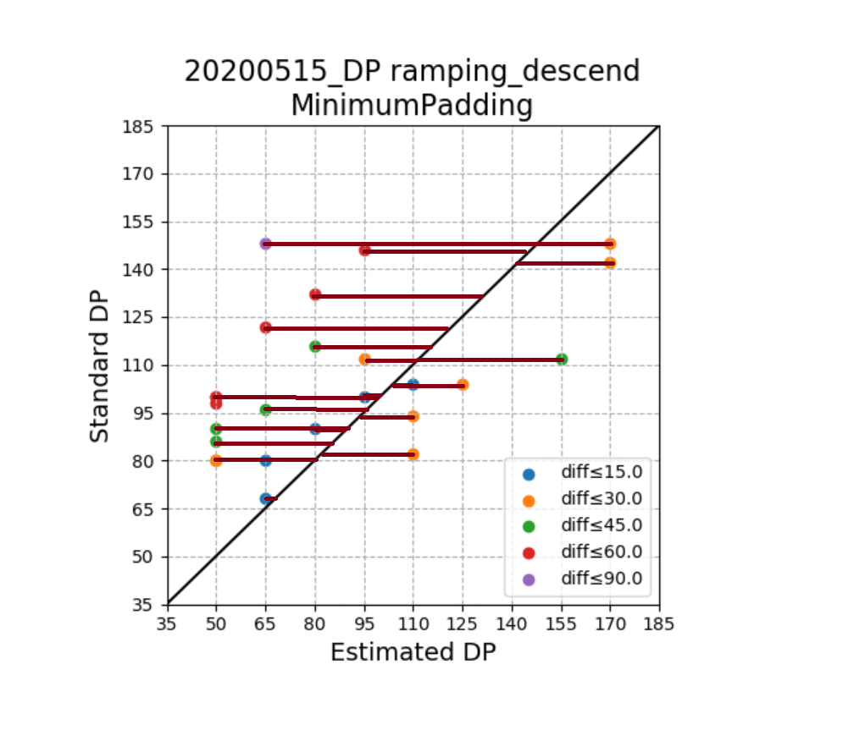
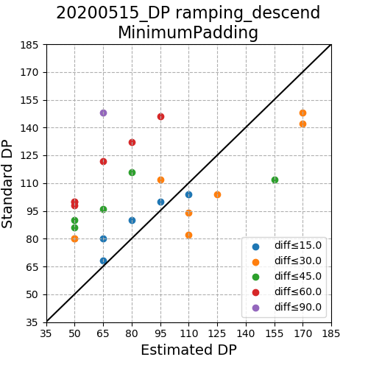
Assessment – 1. Minimum of Distance to Standard Results (Difference)
Accuracy?

Slide 8
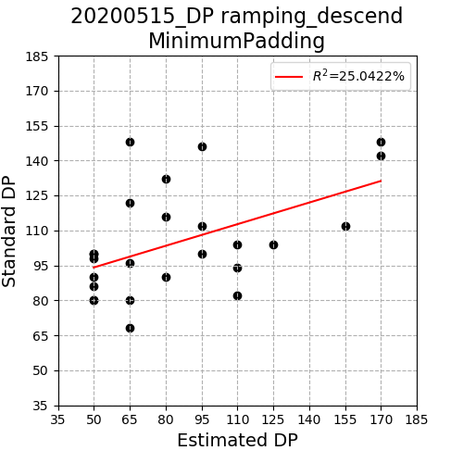
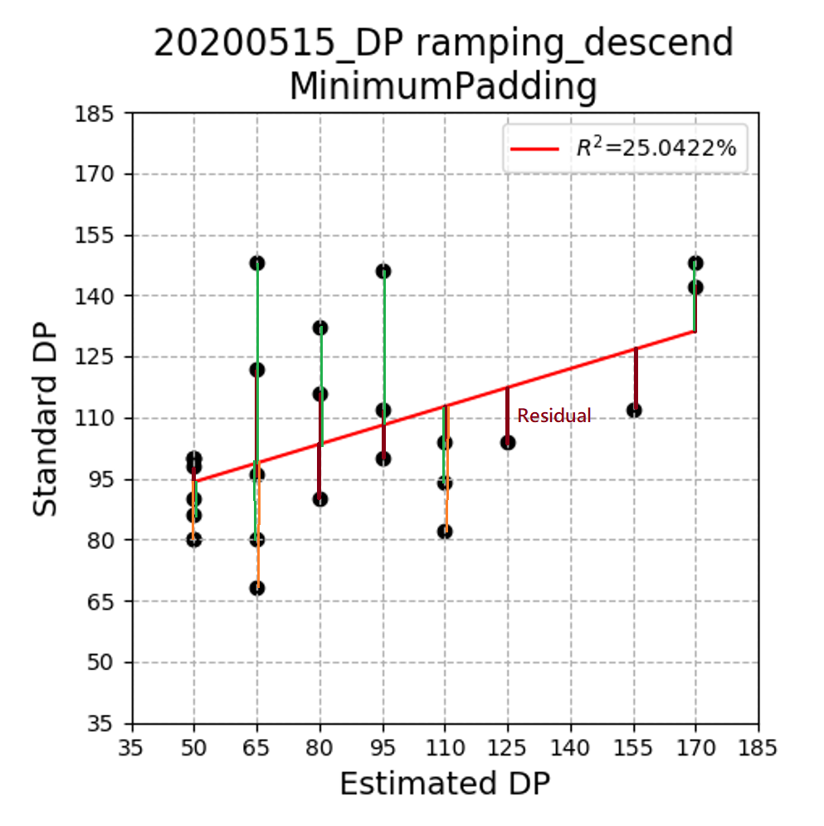
Assessment – 2. Minimum of Mean Square Error (MSE)
Linearity? → Need adjustment

Slide 9
4 Methods to Predict
 Regression
 SG smooth
 Bézier Curve
 SG smooth + Bézier



Slide 10
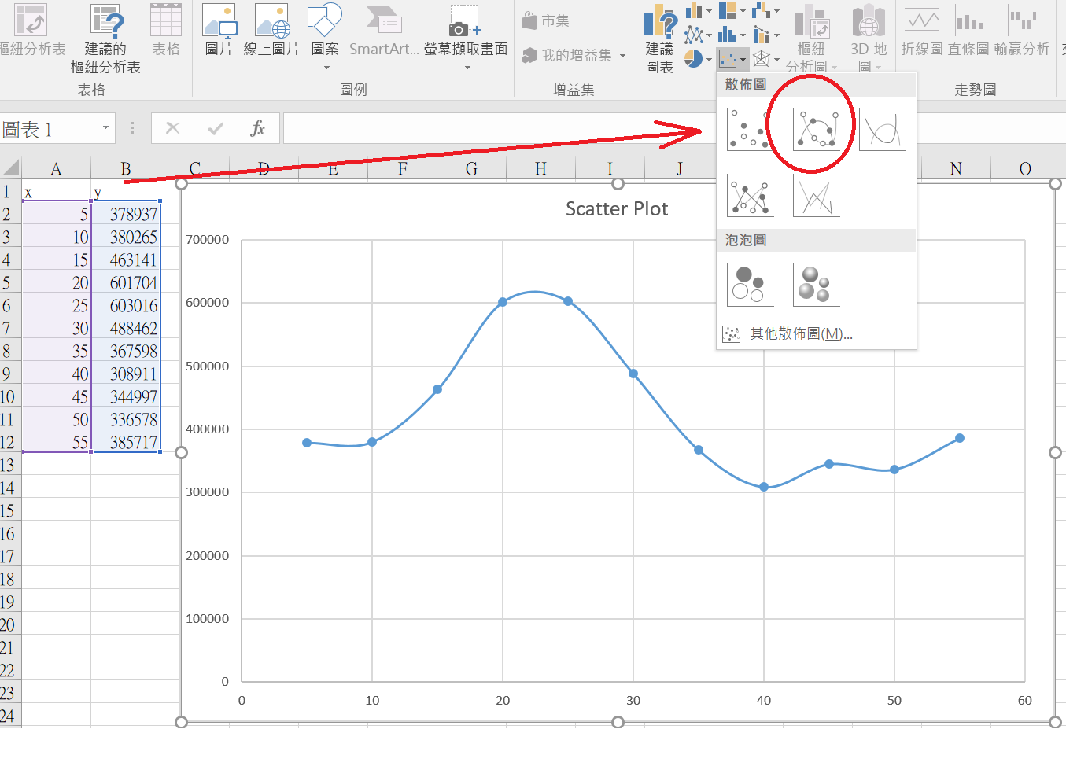
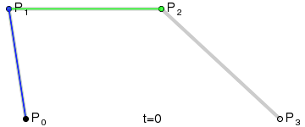
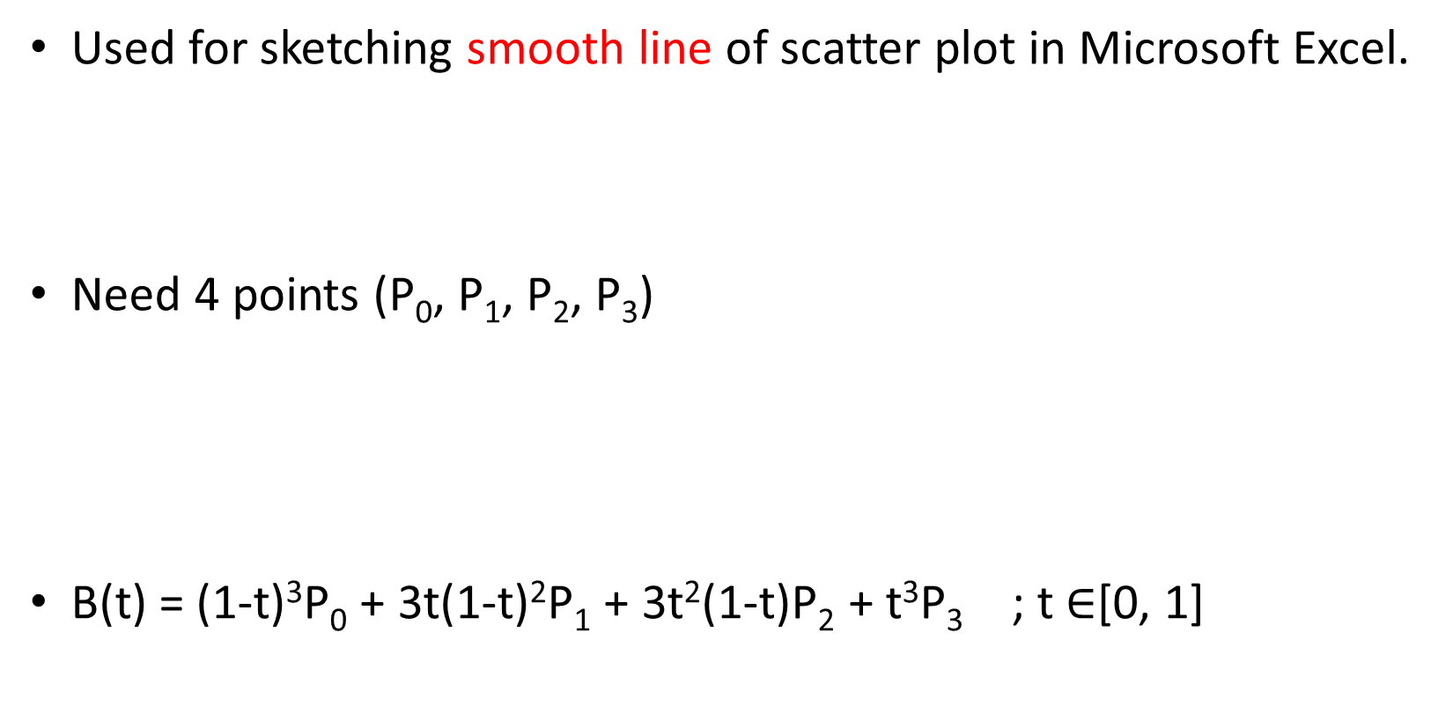
Cubic Bézier Curve
Used for sketching smooth line of scatter plot in Microsoft Excel.
Need 4 points (P₀, P₁, P₂, P₃)
B(t) = (1-t)³P₀ + 3t(1-t)²P₁ + 3t²(1-t)P₂ + t³P₃ ; t $∈$[0, 1]
empirical method
start
end

Slide 11
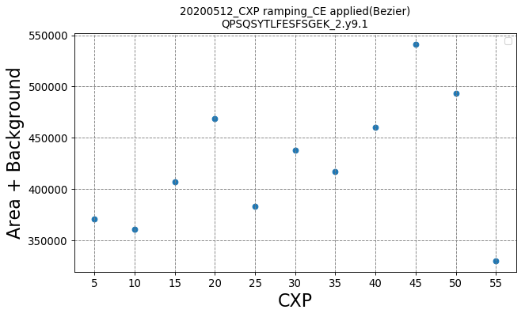
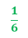
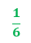
interpolation
$$\frac{1}{6}$$
1
3
$$\frac{1}{6}$$
4
2

Slide 12
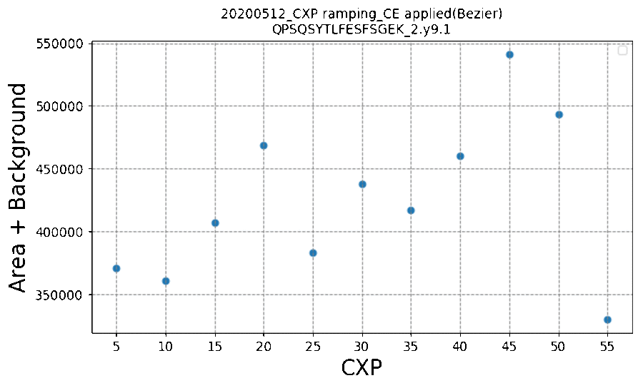
Cubic Bézier Curve

Slide 13
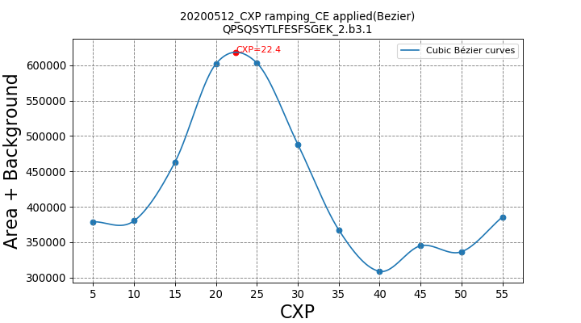
Comparison b/t Cubic Bézier & Microsoft Excel
Cubic Bézier
Microsoft Excel

Slide 14
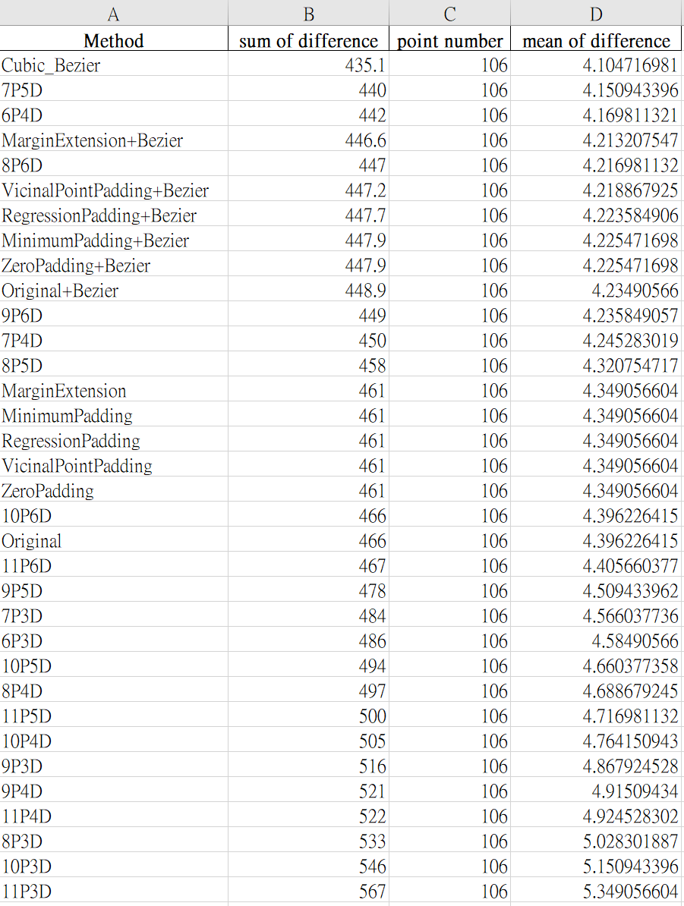
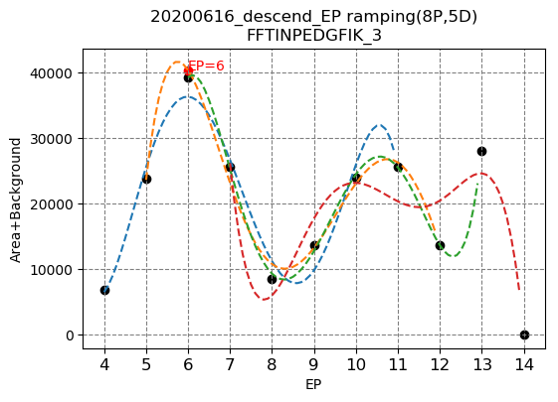
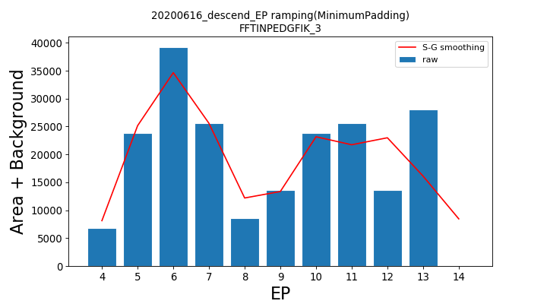
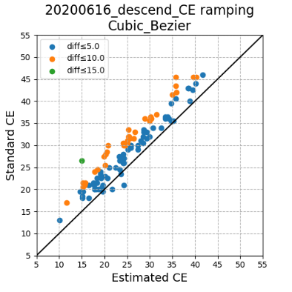
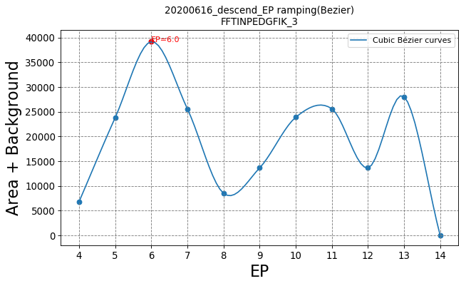
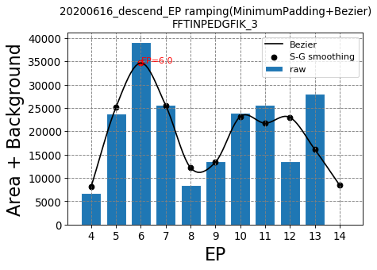
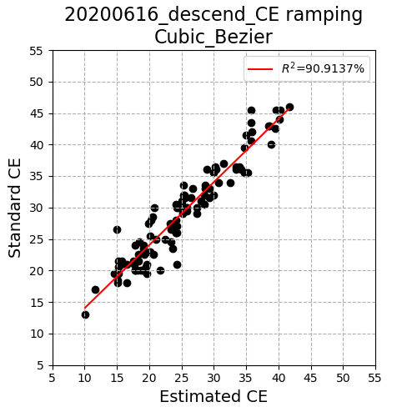
Established Packages
Optimal Parameter (DP, EP, CE, CXP) Estimation
Regression (n Points, m Degree)
Bézier Curve
SG smoothing
SG smoothing + Bézier Curve
Accuracy Calculation :
Difference
MSE
Data
Summary Table

Slide 15
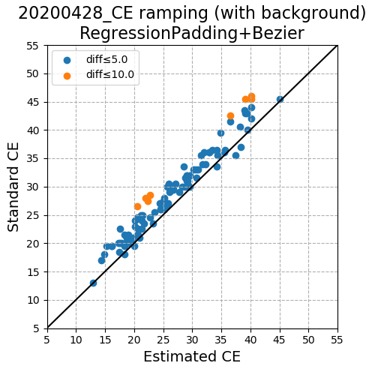
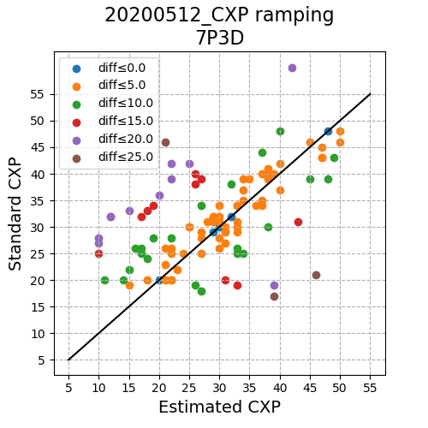
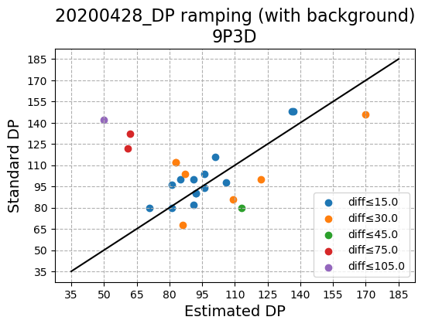
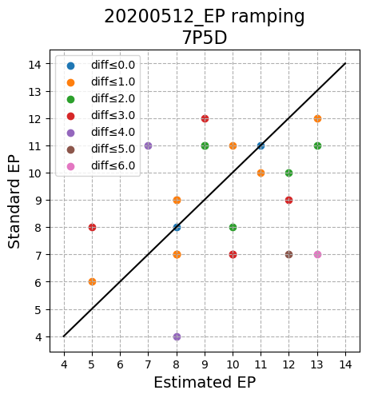
Results - Prediction ability
CE > CXP >> DP > EP
>
>
>

Slide 16
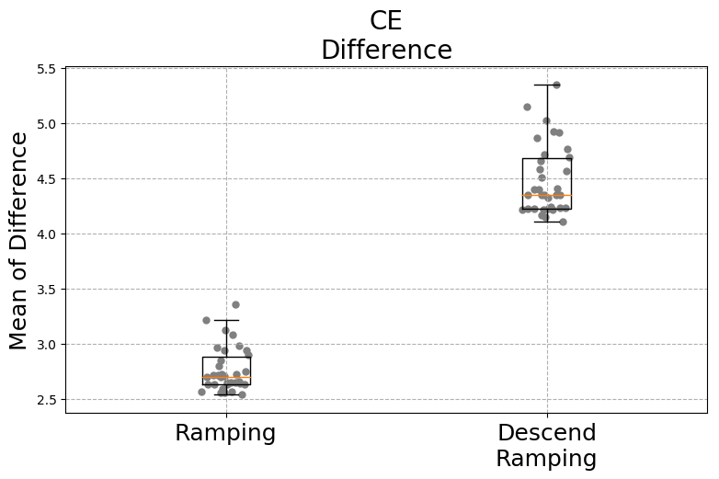
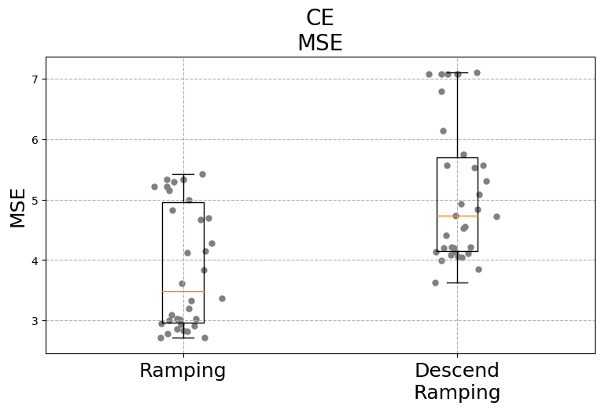
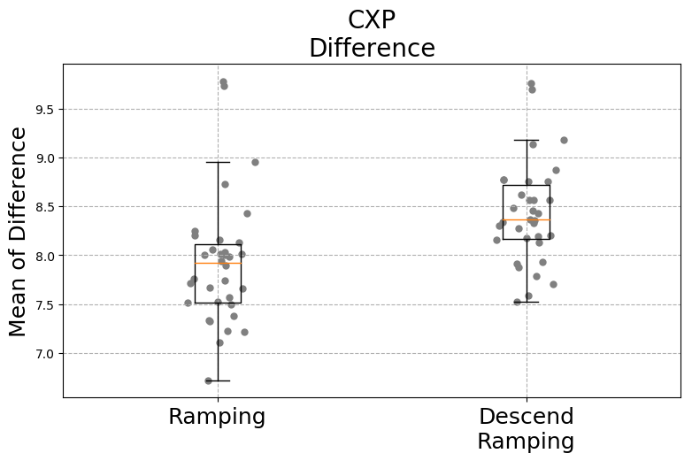
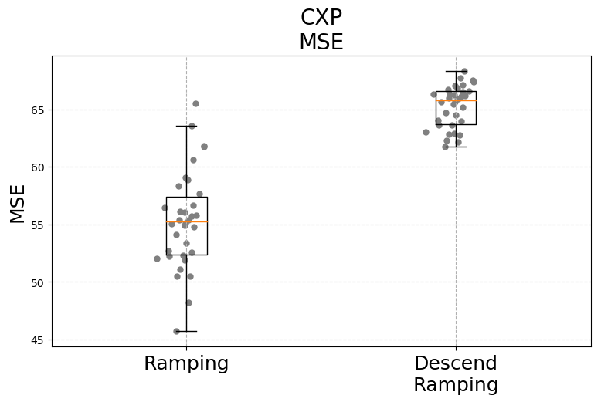
Results - Ramping vs Descend Ramping
Difference
MSE
CE
5->10->15->20…
55->50->45->40…
CXP

Slide 17
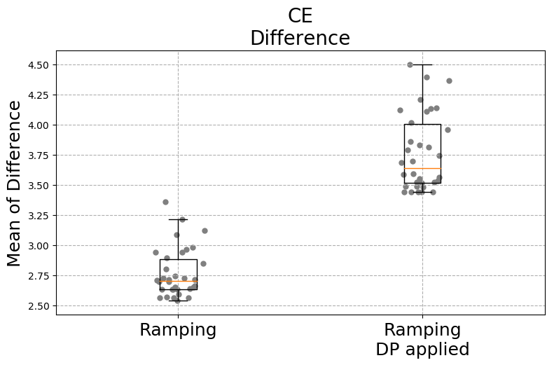
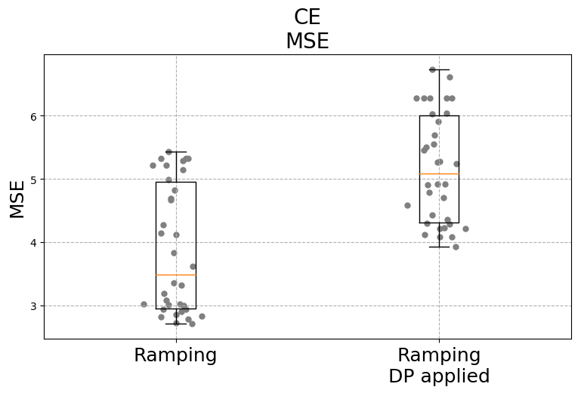
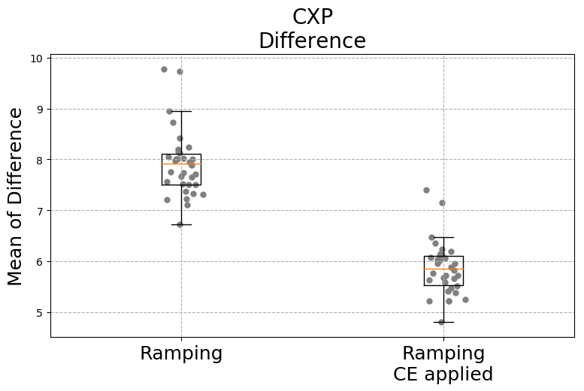

Results – Optimal Parameter applied
Difference
MSE
CE
CXP

Slide 18




Results – Optimal Parameter applied
Difference
MSE
DP
EP

Slide 19
Workflow

Peptides sequences
Input file (.csv/.xslx/.txt) with
format fixed columns
m/z calculation
Available m/z range (e.g. 350-1250)
m/z overlap note (∆ < 0.1)
Light & Heavy type

CXP formula
MRM acquisition methods (CE ramping)
Optional
CXP = a*Q3+b (a, b would vary between machines)
CE determination
Top N Q1/Q3 pairs selection

1.
Default parameters Ramping mid point/interval/steps
3.
3.
2.

DP
ramping
EP
ramping
CXP
ramping
Fitting method Top 10-15 (predicted peak area)
DP/EP/CXP determination
Top N Q1/Q3 pairs selection

Fitting method Top 4-10 (predicted peak area)
Check run (repeat 3 times)
Top 3-6 (real peak area)
Final method

Slide 20
Part B. Shotgun Proteomics - peptide p-value & q-value

Slide 21

Shotgun Proteomics

Slide 22

Spectrum
Peptide
Protein
isoform
Protein
FDR,
q-value
PSM
score
Protein
FDR
Peptide
Score
PSM
score

Slide 23

Workflow
Peptide Sequence
Target / Decoy
Score
QGQ….QSR
Target
6.421
MLA…SSR
Decoy
3.407
.
.
.
.
.
.
.
.
.
.
.
.
.
.
.
.
.
.
SQLite3
200,000 rows
*
800 files

